Slide 1


Introduction to MLOps
Anish Mahapatra | 30 June, 2022

Slide 2

Agenda
01
Introduction
02
The current and future state of ML
03
Technical debt in Machine Learning Systems
04
New world machine learning
05
Tools & Technologies for MLOps
06
Q&A Session

Slide 3












Topic 1 of 6
Introduction: Am I worth your time?
Lead Data Scientist
LinkedIn: www.linkedin.com/in/anishmahapatra Medium: anishmahapatra.medium.com Website: www.anishmahapatra.com
GitHub: www.github.com/anishmahapatra
Q. What is the future of Data Science?
A. Simple, ask a real-world Data Scientist.

Slide 4
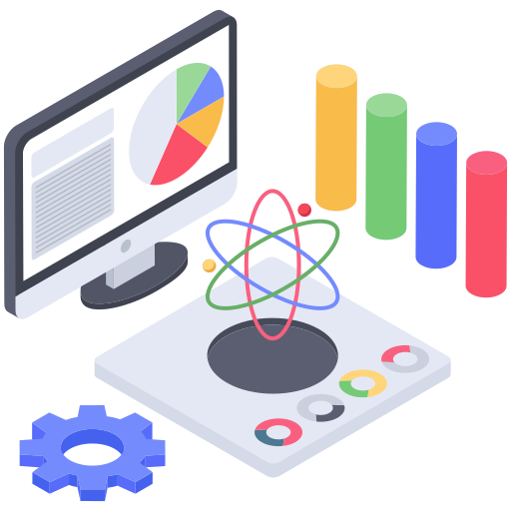
Topic 2 of 6
Current State of ML
87% of Data Science projects do not make it to production. (Source)
Why?

Slide 5
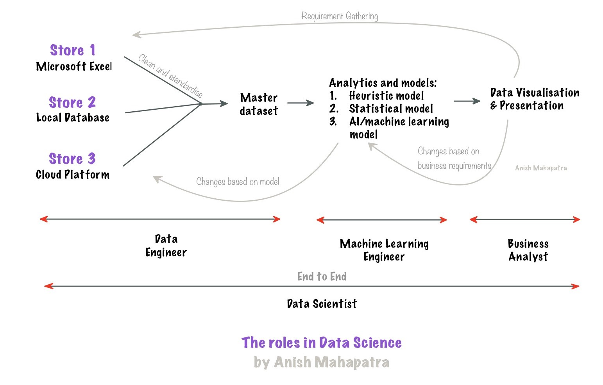
Topic 2 of 6
Current State of ML

Slide 6




Topic 2 of 6
Roles in Data Science
01
02
03
04
Data Engineer
Data Scientist
Machine Learning Engineer
Business Analyst
Data Movement, Building Data pipelines, Quality of Data, Data Governance
Data Wrangling, Feature Engineering, Experimentation, Hypothesis Testing, Scaling from prototype to production
Experimentation, Combination of ML and Engineering applications, Deployment, Model observability, Model monitoring
Client communication & management, Dashboarding & Reporting, Visualization, Decision Making
Notes:
Source: https://databricks.com/blog/2020/08/03/modern-industrial-iot-analytics-on-azure-part-1.html

Slide 7
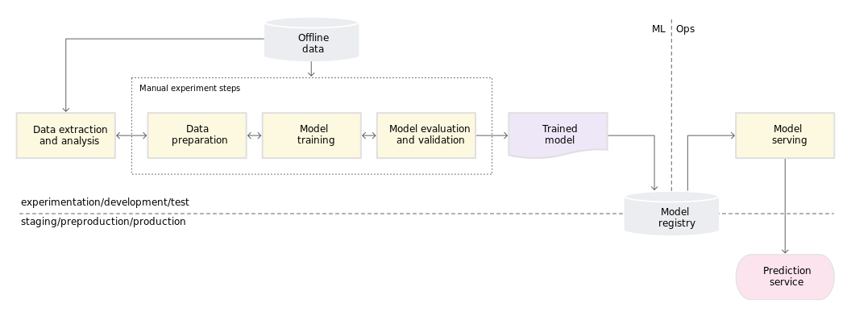
Topic 2 of 6
Current State of ML
Source: MLOps Continuous delivery and automation pipelines in Machine Learning by Google Cloud:
Notes:
Source: https://cloud.google.com/architecture/mlops-continuous-delivery-and-automation-pipelines-in-machine-learning

Slide 8
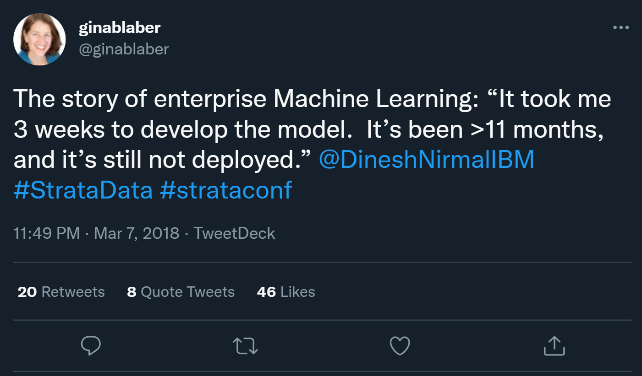
Topic 2 of 6
Current State of Enterprise ML
Source: @ginablaber (Twitter)
Notes:
Source: https://cloud.google.com/architecture/mlops-continuous-delivery-and-automation-pipelines-in-machine-learning

Slide 9
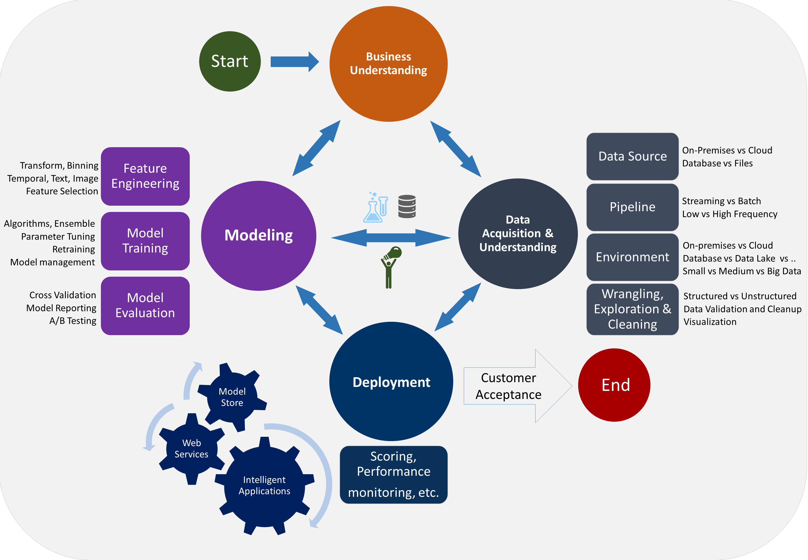
Topic 2 of 6
Current State of Enterprise ML
Notes:
Source: https://cloud.google.com/architecture/mlops-continuous-delivery-and-automation-pipelines-in-machine-learning

Slide 10
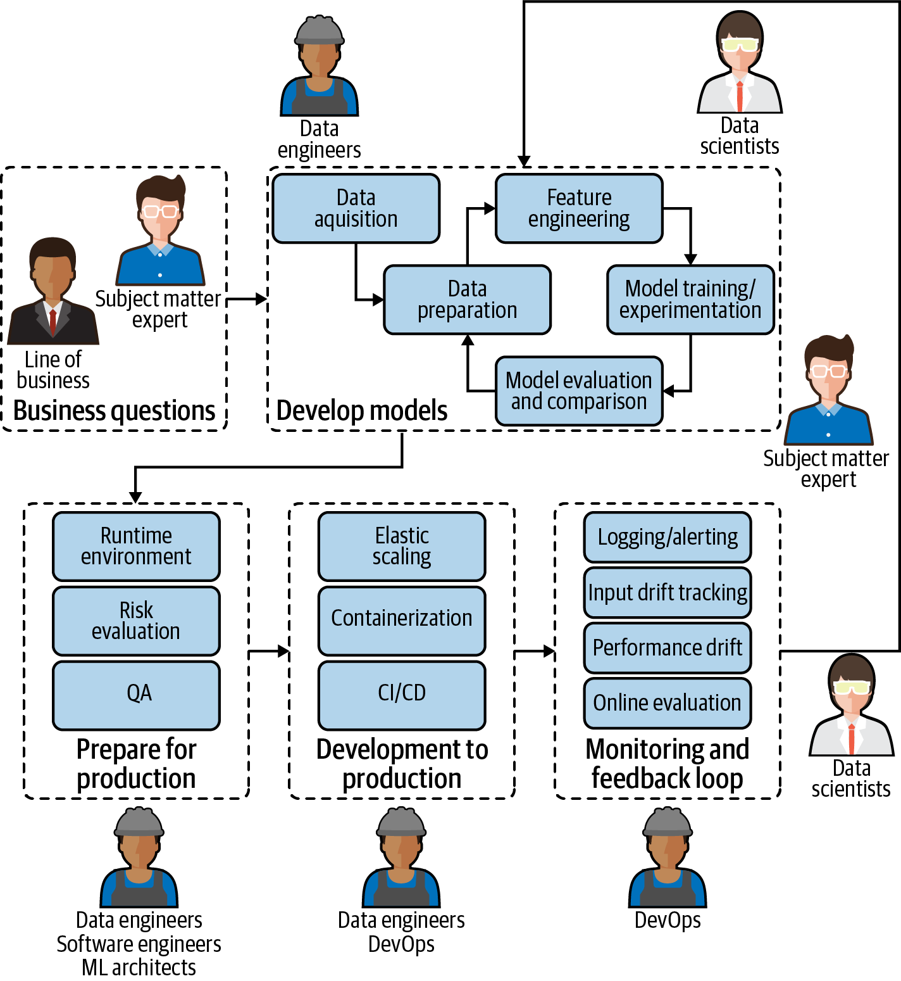
Topic 2 of 6
Future State of ML
Source: O’Reilly
Notes:
Source: https://cloud.google.com/architecture/mlops-continuous-delivery-and-automation-pipelines-in-machine-learning

Slide 11
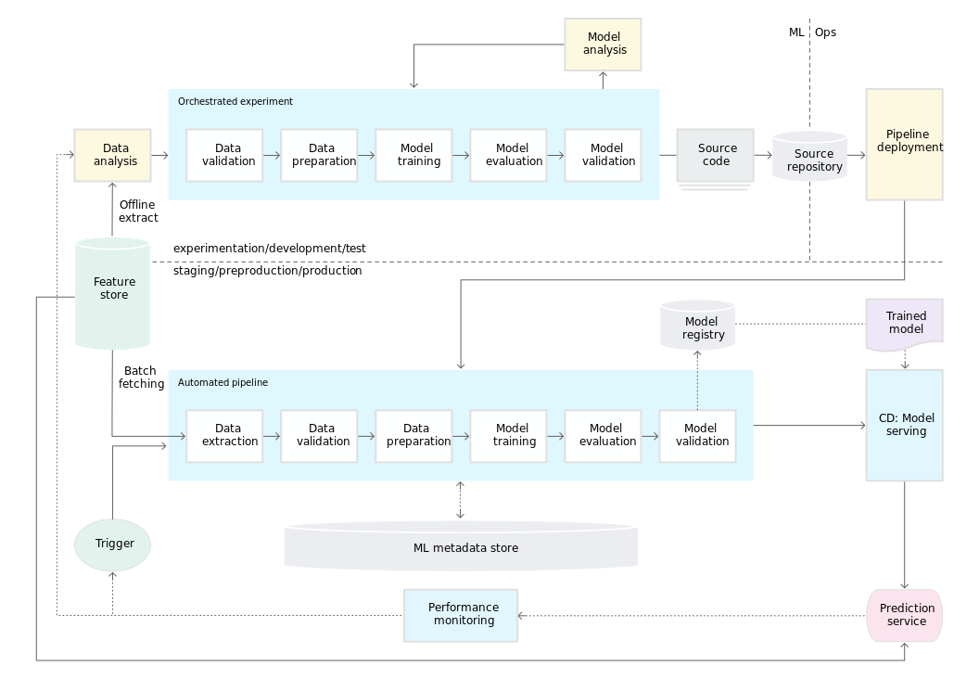
Topic 2 of 6
Future State of Enterprise ML
Source: MLOps Continuous delivery and automation pipelines in Machine Learning by Google Cloud:
Notes:
Source: https://cloud.google.com/architecture/mlops-continuous-delivery-and-automation-pipelines-in-machine-learning

Slide 12
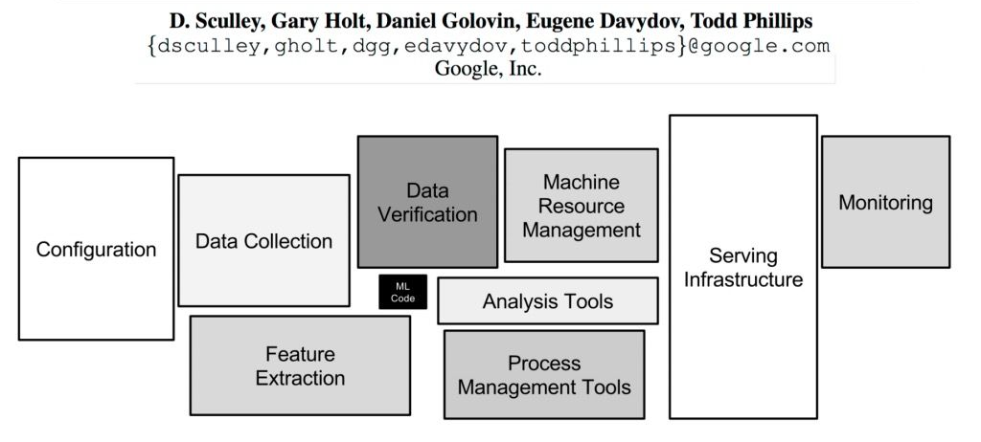
Topic 3 of 6
Hidden Technical Debt in ML Systems

Slide 13


Topic 3 of 6
Hidden Technical Debt in ML Systems
Complex Models erode boundaries
Data Dependencies cost more than code dependencies
ML System Anti-patterns:
Glue code
Dead Experiments
How to combat Technical Debt?
Monitoring
Data versioning & Model Metadata
ML Tools (Weights & Biases, MLflow, KubeFlow)

Slide 14

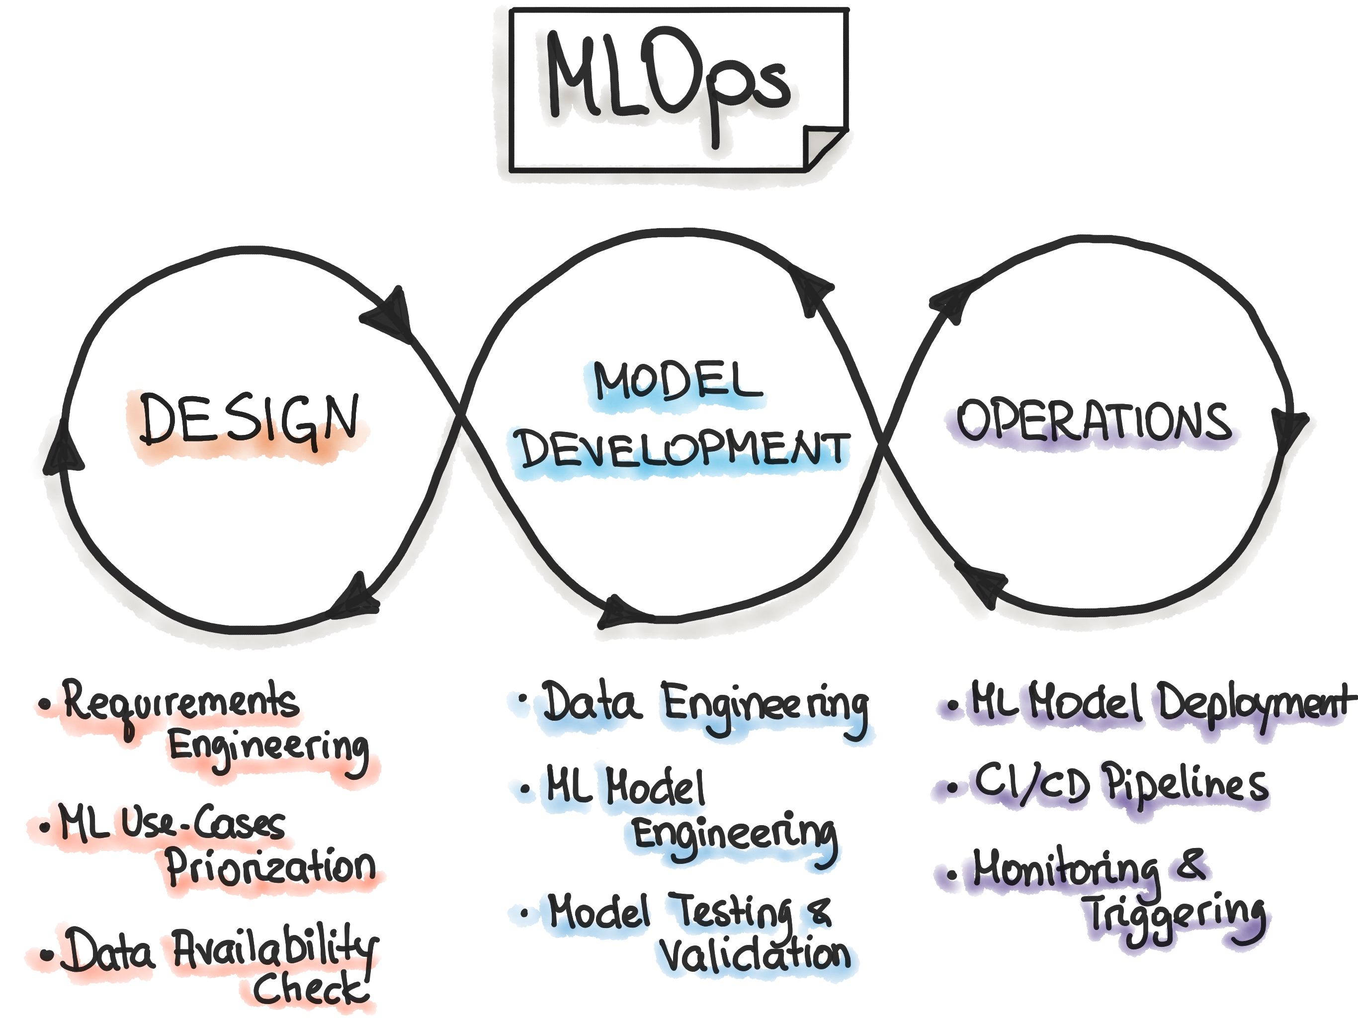

Topic 4 of 6
New world Machine Learning
MLOps is to optimize the hand-off between Data Scientists and Machine Learning Engineers
MLOps Goals
Faster experimentation and model development
Faster deployment of updated models into production
Quality Assurance
What is MLOps?
MLOps is a process that encourages Data Scientists/Engineering teams to collaborate and increase the pace of
Model Development
Continuous Integration + Deployment
Proper monitoring, validation & governance

Slide 15
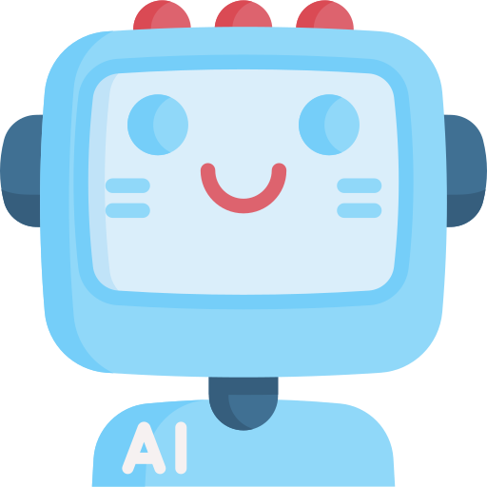
Topic 4 of 6
New world Machine Learning
Why do we need MLOps?
Automatic validation
Experimentation
Track metrics
Monitor model performance
Version control
Data, Model, Code
Automated retraining, Model Observability
Checkpoints in
ML Lifecycle
Interpretability, Fairness, Responsible ML, Audit trail

Slide 16
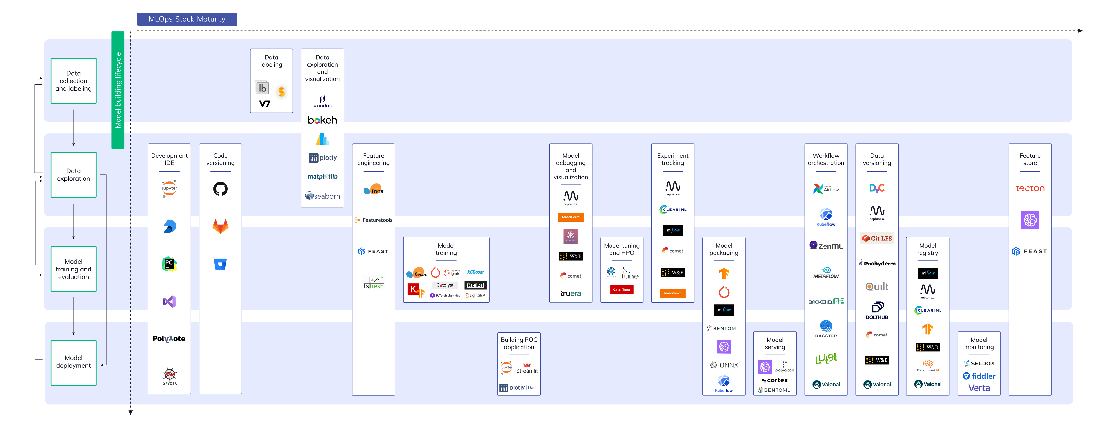
Topic 5 of 6
Tools & Technologies for MLOps

Slide 17
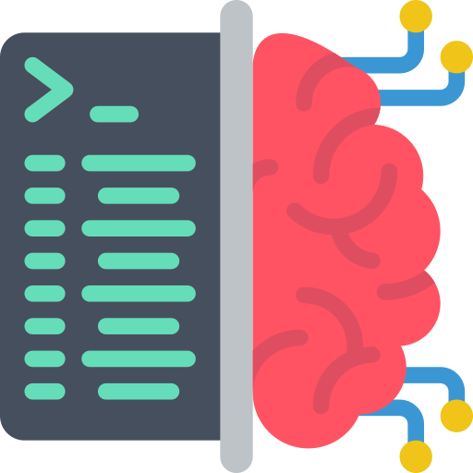
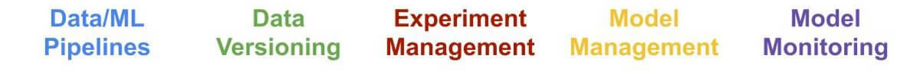


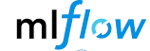
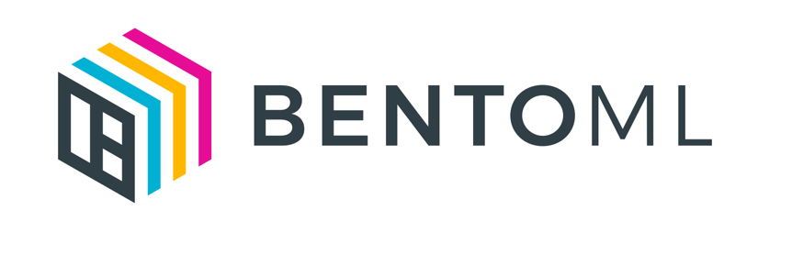



Topic 4 of 6
Tools & Technologies for MLOps
How to perform MLOps?
Create reproducible ML pipelines (Automation)
Enable reusable ML environments
Register, package and deploy models
Capture governance data for end-to-end lifecycle
Generate Alerts
Monitor ML Applications (efficacy, infrastructure)
Automate the end-to-end ML lifecycle
Audit trail creation for all artifacts (asset integrity and regulatory requirements)

Slide 18
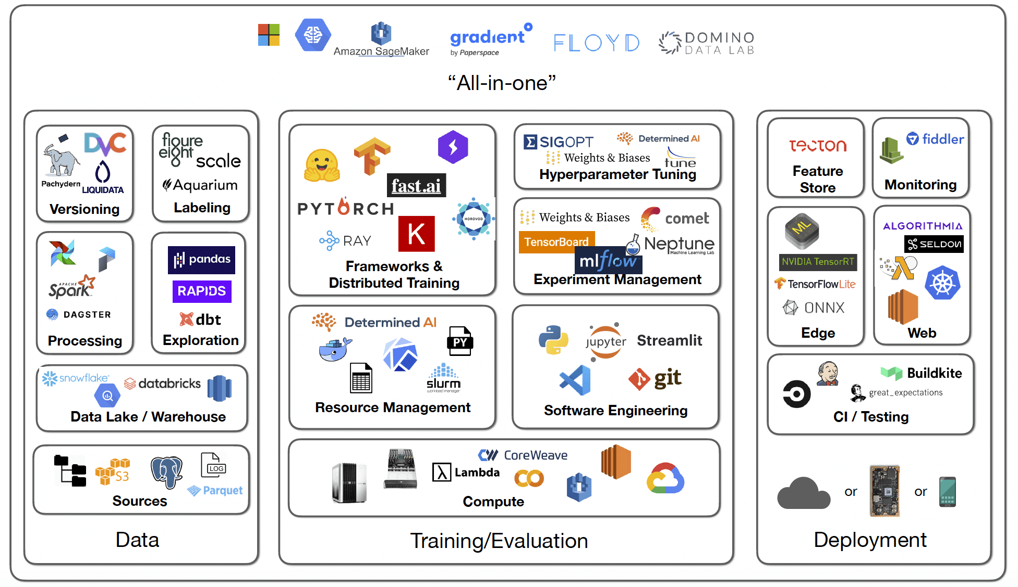
Topic 5 of 6
Tools & Technologies for MLOps

Slide 19
Key Takeaways
01
Fundamentals of MLOps
02
How to scale Data Science projects?
03
Hidden Technical Debt in Machine Learning Systems
04
The current and future state of machine learning
05
Tools and technologies used in MLOps
Notes:
Expertrons Company Profile: Valuation & Investors | PitchBook

Slide 20

Introduction to MLOps
Anish Mahapatra
Q&A Session
LinkedIn: www.linkedin.com/in/anishmahapatra
Email: anishmahapatra01@gmail.com

